Slide 1
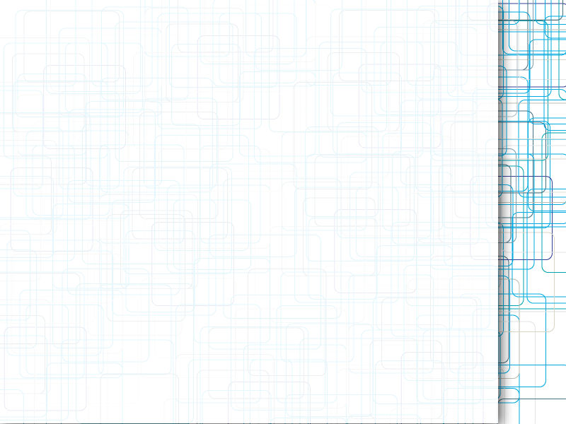
CalPlug EMS
Shivam Patel
Progress Update
5/30/12

Slide 2
Current Tasks
Collecting waveforms for various loads
Analyzing FFT and its uses
Learning LabVIEW

Slide 3
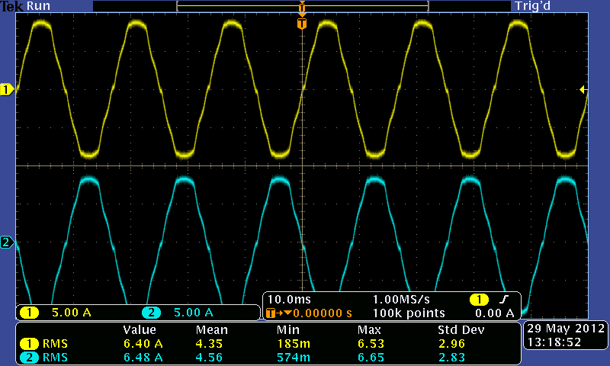
Current Probe Calibration
Calibrated two new current probes

Slide 4
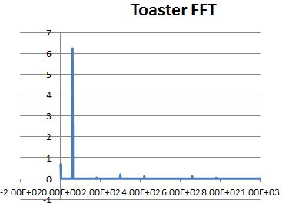
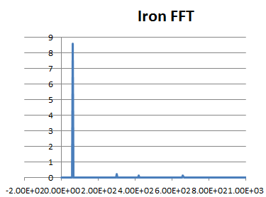
FFT Page 1

Slide 5
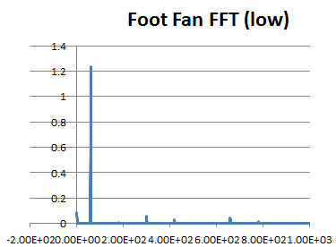
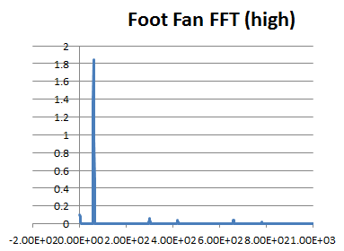
FFT Page 2

Slide 6
What's Next
Using LabVIEW to get full waveform over period of time
  Want to analyze outside of instantaneous frame
  Different modes for devices

